Slide 1
Worked Problems on Gauss Law

Slide 2

22.2 .. A flat sheet is in the shape of a rectangle with sides of lengths 0.400 m and 0.600 m. The sheet is immersed in a uniform electric field of magnitude 90.0 N/C that is directed at 20º from the plane of the sheet (Fig. E22.2). Find the magnitude of the electric flux through the sheet.
$$\vec{A}$$
$$Φ_{E}=\vec{E}∙\vec{A}=EAcosθ=\left(90.0\frac{N}{C}\right)\left(\left(0.400 m\right)0.600 m\right)cos{70}^{o}=7.39 \frac{N∙m^{2}}{C}$$

Slide 3
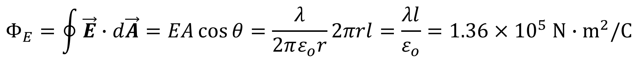
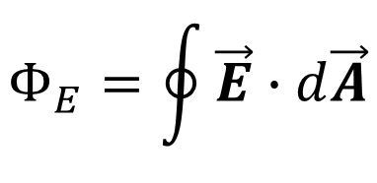
22.4 . It was shown in Example 21.10 (Section 21.5) that the electric field due to an infinite line of charge is perpendicular to the line and has magnitude E = λ/2πε_{o}r. Consider an imaginary cylinder with radius r = 0.250 m and length l = 0.400 m that
has an infinite line of positive charge running along its axis. The charge per unit length on the line is λ = 3.00 μC/m. (a) What is the electric flux through the cylinder due to this infinite line of charge? (b) What is the flux through the cylinder if its radius is increased to r = 0.500 m? (c) What is the flux through the cylinder if its length is increased to l = 0.800 m?
$$Φ_{E}=\oint{\vec{E}∙d\vec{A}}$$
$$Φ_{E}=\oint{\vec{E}∙d\vec{A}=EA\cos{θ}=\frac{λ}{2πε_{o}r}2πrl}=\frac{λl}{ε_{o}}=1.36×{10}^{5} N∙m^{2}/C$$

Slide 4
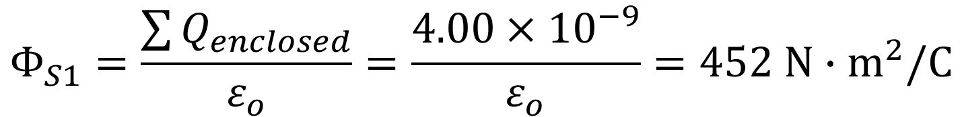
22.8 . The three small spheres shown in Fig. E22.8 carry charges q1 = 4.00 nC, q2 = -7.80 nC, and q3 = 2.40 nC. Find the net electric flux through each of the following closed surfaces shown in cross section in the figure: (a) S1 ; (b) S2 ; (c) S3 ; (d) S4 ; (e) S5 .
$$Φ_{S1}=\frac{\sum{Q_{enclosed}}}{ε_{o}}=\frac{4.00×{10}^{−9}}{ε_{o}}=452 N∙m^{2}/C$$

Slide 5
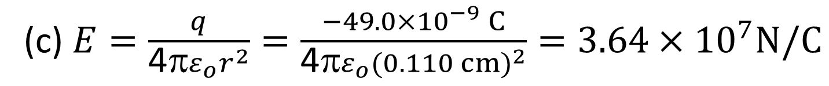
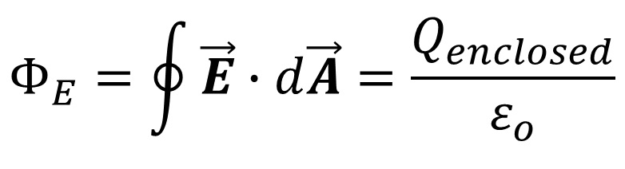
22.9 A charged paint is spread in a very thin uniform layer over the surface of a plastic sphere of diameter 12.0 cm, giving it a charge of -49.0 μC. Find the electric field (a) just inside the paint layer; (b) just outside the paint layer; (c) 5.00 cm outside the surface of the paint layer.
$$Φ_{E}=\oint{\vec{E}∙d\vec{A}=\frac{Q_{enclosed}}{ε_{o}}}$$
(c) $E=\frac{q}{{\text{4π}ε}_{o}r^{2}}=\frac{−49.0×{10}^{−9} C}{{\text{4π}ε}_{o}{(0.110 cm)}^{2}}=3.64×{10}^{7}N/C$

Slide 6
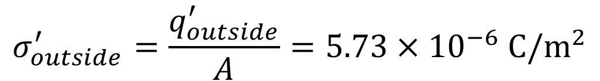

22.19 A hollow, conducting sphere with an outer radius of 0.250 m and an inner radius of 0.200 m has a uniform surface charge density of +6.37 x 10⁻⁶ C/m². A charge of -0.500 μC is now introduced at the center of the cavity inside the sphere. (a) What is the new charge density on the outside of the sphere? (b) Calculate the strength of the electric field just outside the sphere. (c) What is the electric flux through a spherical surface just inside the inner surface of the sphere?
Before the introduction of the charge
σ = +6.37 x 10⁻⁶ C/m²
$$q_{outside}=σA=σ4πr^{2}=5.00×{10}^{−6} C$$
0.200 m
After the introduction of the charge
0.250 m
$$q_{outside}^{′}=5.00×{10}^{−6} C−0.500×{10}^{−6}C$$
$$q_{outside}^{′}=4.50×{10}^{−6} C$$
q = -0.500 μC
$$σ_{outside}^{′}=\frac{q_{outside}^{′}}{A}=5.73×{10}^{−6} C/m^{2}$$

Slide 7

22.19 A hollow, conducting sphere with an outer radius of 0.250 m and an inner radius of 0.200 m has a uniform surface charge density of +6.37 x 10⁻⁶ C/m². A charge of -0.500 μC is now introduced at the center of the cavity inside the sphere. (a) What is the new charge density on the outside of the sphere? (b) Calculate the strength of the electric field just outside the sphere. (c) What is the electric flux through a spherical surface just inside the inner surface of the sphere?
$$σ^{′}=5.73×{10}^{−6} C/m^{2}$$
0.200 m
q = -0.500 μC
0.250 m

Slide 8
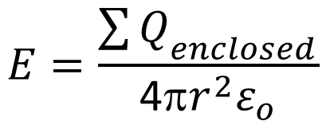
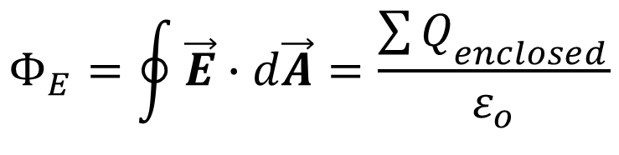
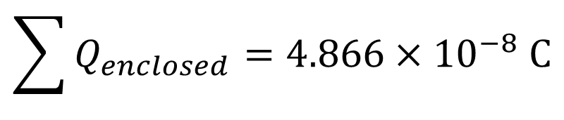
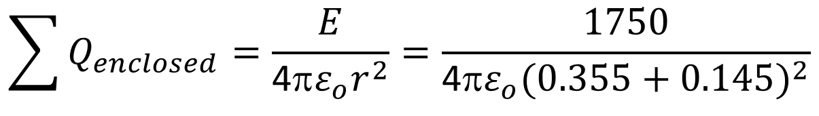
22.21 The electric field at a distance of 0.145 m from the surface of a solid insulating sphere with radius 0.355 m is 1750 N/C. (a) Assuming the sphere’s charge is uniformly distributed, what is the charge density inside it? (b) Calculate the electric field inside
the sphere at a distance of 0.200 m from the center.
$$Φ_{E}=\oint{\vec{E}∙d\vec{A}=\frac{{\sum{Q}}_{enclosed}}{ε_{o}}}$$
+
+
$$E=\frac{{\sum{Q}}_{enclosed}}{{\text{4π}r^{2}ε}_{o}}$$
+
+
+
+
+
+
+
+
R=0.355 m
+
+
+
$$\sum{Q_{enclosed}}=\frac{E}{\text{4π}ε_{o}r^{2}}=\frac{1750}{\text{4π}ε_{o}{(0.355+0.145)}^{2}}$$
+
$$\sum{Q_{enclosed}}=4.866×{10}^{−8} C$$

Slide 9
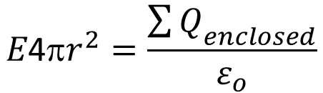
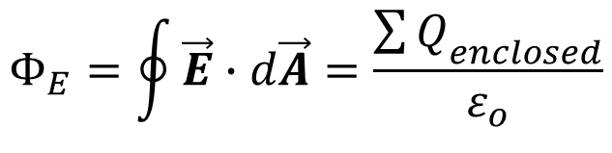
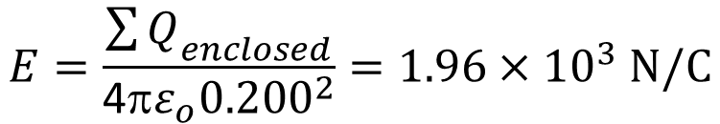
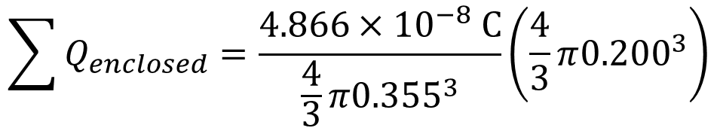
22.21 The electric field at a distance of 0.145 m from the surface of a solid insulating sphere with radius 0.355 m is 1750 N/C. (a) Assuming the sphere’s charge is uniformly distributed, what is the charge density inside it? (b) Calculate the electric field inside
the sphere at a distance of 0.200 m from the center.
$$Φ_{E}=\oint{\vec{E}∙d\vec{A}=\frac{{\sum{Q}}_{enclosed}}{ε_{o}}}$$
+
+
$$E\text{4π}r^{2}=\frac{{\sum{Q}}_{enclosed}}{ε_{o}}$$
+
+
+
+
+
+
+
+
R=0.355 m
$$\sum{Q_{enclosed}}=\frac{4.866×{10}^{−8} C}{\frac{4}{3}π{0.355}^{3}}\left(\frac{4}{3}π{0.200}^{3}\right)$$
+
+
+
+
$$E=\frac{{\sum{Q}}_{enclosed}}{\text{4π}ε_{o}{0.200}^{2}}=1.96×{10}^{3} N/C$$

Slide 10
22.44 A conducting spherical shell with inner radius a and outer radius b has a positive
point charge Q located at its center. The total charge on the shell is -3Q, and it is insulated from its surroundings (Fig. P22.44). (a) Derive expressions for the electric-field magnitude E in terms of the distance r from the center for the regions r < a,
a < r < b, and r > b. What is the surface charge density (b) on the inner surface of the conducting shell; (c) on the outer surface of the conducting shell? (d) Sketch the electric field lines and the location of all charges.

Slide 11
What is the surface charge density (b) on the inner surface of the conducting shell;
Since a Gaussian surface with radius r, for a < r < b, must enclose zero net charge because E = 0 inside the conductor, the total charge on the inner surface is −Q and the surface charge density on the inner surface is
(c) on the outer surface of the conducting shell?
Since the net charge on the shell is −3Q and there is −Q on the inner surface, there must be −2Q on the outer surface. The surface charge density on the outer surface is

Slide 12
(d) Sketch the electric field lines and the location of all charges.

